Slide 1
Paging and Demand Paging

Slide 2
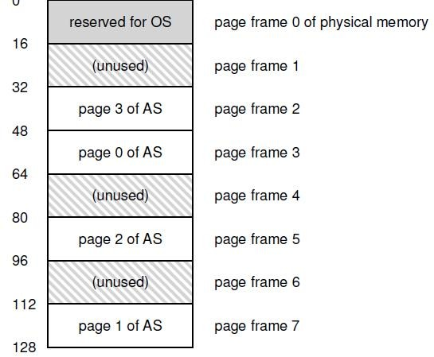
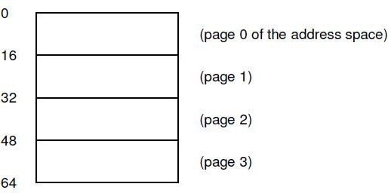
Paging
Allocate memory in fixed size chunks (“pages”)
Avoids external fragmentation (no small “holes”)
Has internal fragmentation (partially filled pages)

Slide 3
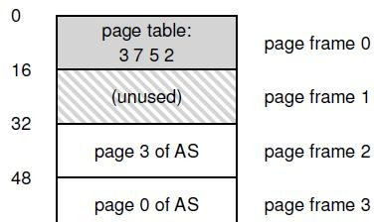
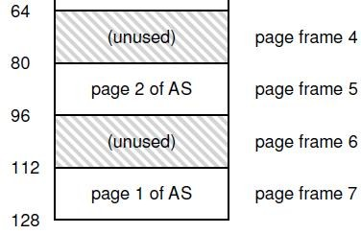
Page table
Per process data structure to help VA-PA translation
Array stores mappings from virtual page number (VPN) to physical frame number (PFN)
– E.g., VP 0 → PF 3, VP 1 → PF 7
Part of OS memory (in PCB)
MMU has access to page table and uses it for address translation
OS updates page table upon context switch

Slide 4
Page table entry (PTE)
Simplest page table: linear page table
Page table is an array of page table entries, one per virtual page
VPN (virtual page no.) is index into this array
Each PTE contains PFN (physical frame number) and few other bits
Valid bit: is this page used by process?
Protection bits: read/write permissions
Present bit: is this page in memory? (more later)
Dirty bit: has this page been modified?
Accessed bit: has this page been recently accessed?

Slide 5
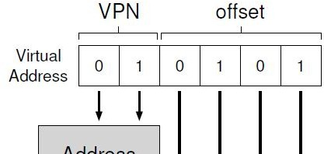
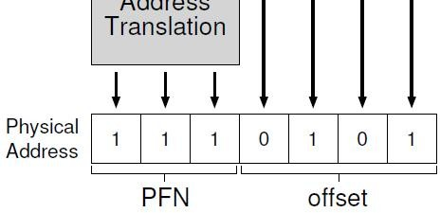
Address translation in hardware
Most significant bits of VA give the VPN
Page table maps VPN to PFN
PA is obtained from PFN and offset within a page
MMU stores (physical) address of start of page table, not all entries.
“Walks” the page table to get relevant PTE

Slide 6
What happens on memory access?
CPU requests code or data at a virtual address
MMU must translate VA to PA
First, access memory to read page table entry
Translate VA to PA
Then, access memory to fetch code/data
Paging adds overhead to memory access
Solution? A cache for VA-PA mappings

Slide 7
Translation Lookaside Buffer (TLB)
A cache of recent VA-PA mappings
To translate VA to PA, MMU first looks up TLB
If TLB hit, PA can be directly used
If TLB miss, then MMU performs additional memory accesses to “walk” page table
TLB misses are expensive (multiple memory accesses)
– Locality of reference helps to have high hit rate
TLB entries may become invalid on context switch and change of page tables

Slide 8
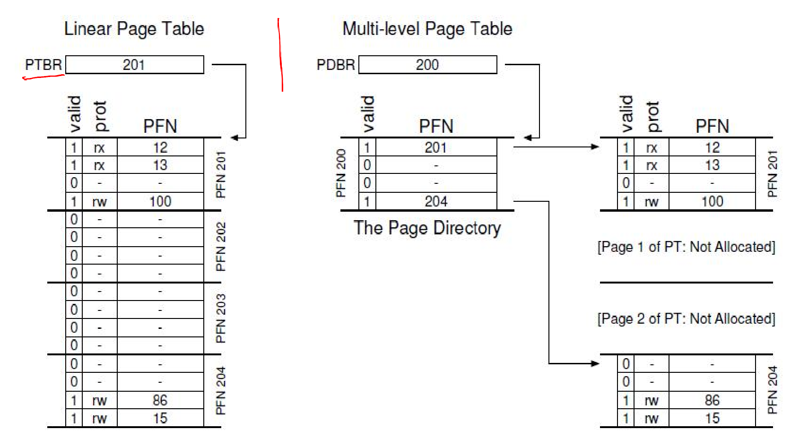
Multilevel page tables (1)
A page table is spread over many pages
An “outer” page table or page directory tracks the PFNs of the page table pages

Slide 9
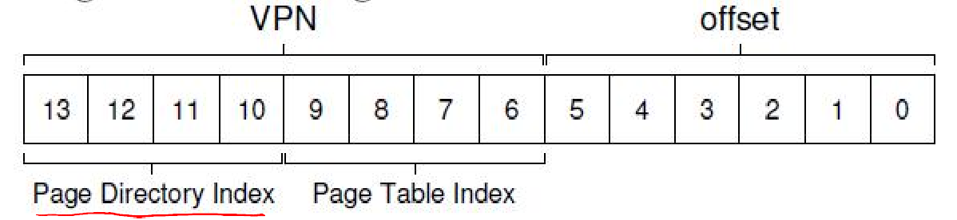
Multilevel page tables (2)
Depending on how large the page table is, we may need more than 2 levels also
64-bit architectures may need 7 levels
What about address translation?
First few bits of VA to identify outer page table entry
Next few bits to index into next level of PTEs
In case of TLB miss, multiple accesses to memory required to access all the levels of page tables

Slide 10
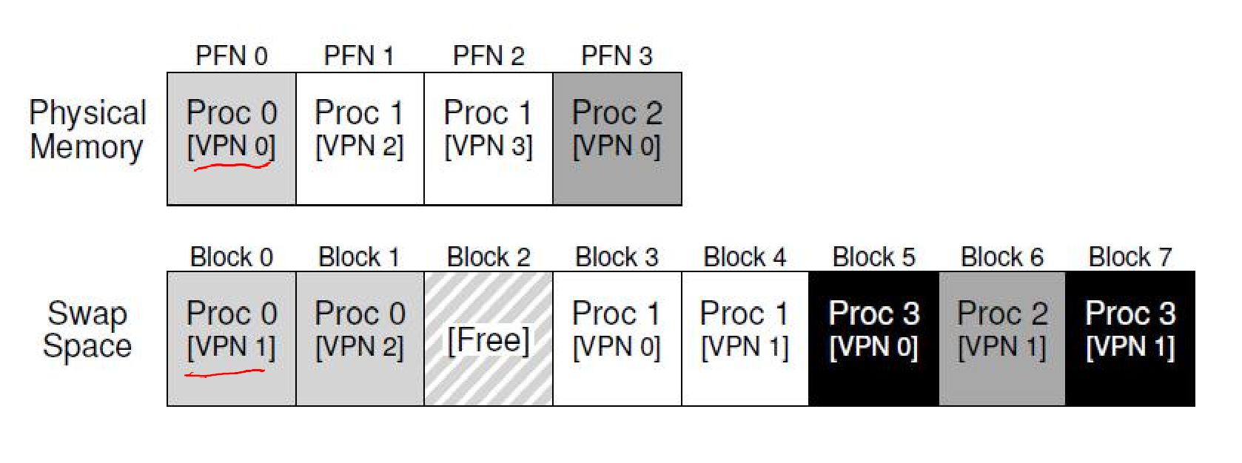
Is main memory always enough?
Are all pages of all active processes always in main memory?
– Not necessary, with large address spaces
OS uses a part of disk (swap space) to store pages that are not in active use
10

Slide 11
Page fault
Present bit in page table entry: indicates if a page of a process resides in memory or not
When translating VA to PA, MMU reads present bit
If page present in memory, directly accessed
If page not in memory, MMU raises a trap to the OS – page fault
11

Slide 12
Page fault handling
Page fault traps OS and moves CPU to kernel mode
OS fetches disk address of page and issues read to disk
OS keeps track of disk address (say, in page table)
OS context switches to another process
Current process is blocked and cannot run
When disk read completes, OS updates page table of process, and marks it as ready
When process scheduled again, OS restarts the instruction that caused page fault
12

Slide 13
Summary: what happens on memory access
CPU issues load to a VA for code or data
Checks CPU cache first
Goes to main memory in case of cache miss
MMU looks up TLB for VA
If TLB hit, obtains PA, fetches memory location and returns to CPU (via CPU caches)
If TLB miss, MMU accesses memory, walks page table, and obtains page table entry
If present bit set in PTE, accesses memory
If not present but valid, raises page fault. OS handles page fault and restarts the CPU load instruction
If invalid page access, trap to OS for illegal access
5

Slide 14
More complications in a page fault
When servicing page fault, what if OS finds that there is no free page to swap in the faulting page?
OS must swap out an existing page (if it has been modified, i.e., dirty) and then swap in the faulting page – too much work!
OS may proactively swap out pages to keep list of free pages handy
Which pages to swap out? Decided by page replacement policy.

Slide 15
Page Replacement Algorithms
Want lowest page-fault rate
Evaluate algorithm by running it on a particular string of memory references (reference string) and computing the number of page faults on that string
In all our examples, the reference string is
1, 2, 3, 4, 1, 2, 5, 1, 2, 3, 4, 5

Slide 16
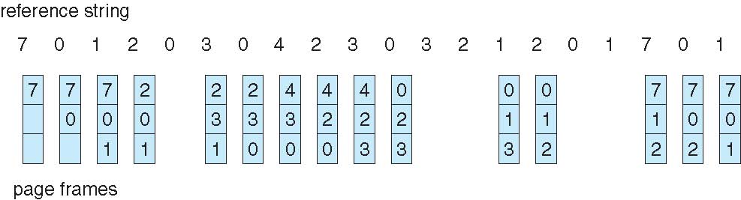
FIFO Page Replacement

Slide 17
Optimal Algorithm
Replace page that will not be used for longest period of time
4 frames example
1, 2, 3, 4, 1, 2, 5, 1, 2, 3, 4, 5
1
4
2
6 page faults
3
4
5

Slide 18
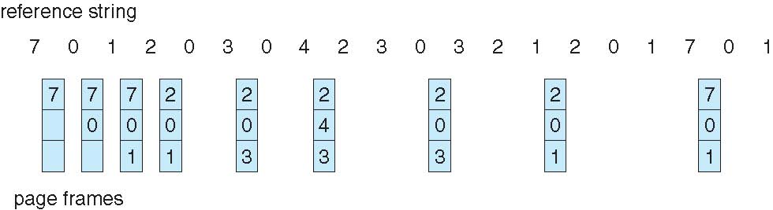
Optimal Page Replacement

Slide 19
Least Recently Used (LRU) Algorithm
Reference string: 1, 2, 3, 4, 1, 2, 5, 1, 2, 3, 4, 5
Counter implementation
Every page entry has a counter; every time page is referenced through this entry, copy the clock into the counter
When a page needs to be changed, look at the counters to determine which are to change
1
1
1
1
5
2
2
2
2
2
3
5
5
4
4
4
4
3
3
3

Slide 20
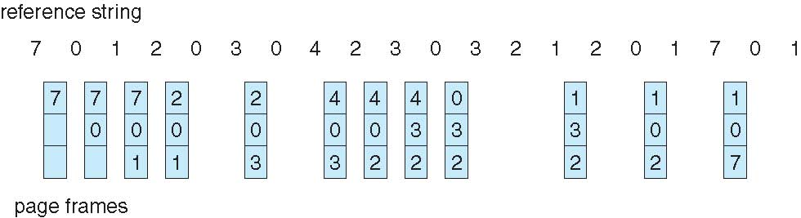
LRU Page Replacement

Slide 21
LRU Algorithm (Cont.)
Stack implementation – keep a stack of page numbers in a double link form:
Page referenced:
move it to the top
requires 6 pointers to be changed
No search for replacement

